Slide 1

Coffee Talk: Law and Policy in Schools
February 12, 2026

Slide 2


WELCOME
Dr. Jamie Kudlats
Dr. Elisabeth Krimbill
Dr. Kevin Brady
Dr. Chris Thomas
Dr. Christy Smith
Dr. Jeanne Surface
Dr. Walter Hart

Slide 3

INTRODUCING
The newest publication from the Education Law Association

Slide 4
RECOMMENDATIONS FROM THE EDITORS
Our mission is to make current education law and policy issues accessible, relevant, and actionable for people concerned about K-12.
Articles are designed to be a quick and informative read (less than five minutes)
Audience of focus is school leaders and teachers
What are the most pressing legal issues today that our school leaders and teachers are facing?

Slide 5

TYPES OF ARTICLES
Feature Articles:
Word count: 750-1,500
Feature articles can cover a variety of topics: free speech issues, special education, due process, privacy, religion, discrimination, torts/liability issues, and anything else with a law or policy angle. Authors should present an issue relevant to teachers or administrators in K-12 schools, incorporate the legal contexts or precedents that inform or govern the issue, and offer implications and considerations for schools and educators.
Advertising space is available

Slide 6
TYPES OF ARTICLES
Commentaries:
Word count: 300-600
Commentaries offer a concise, thoughtful take on a current or timeless issue in education law or policy. They’re meant to spark reflection and dialogue, drawing on professional insight, current events, or recent legal developments. Authors are encouraged to share perspective and experience in a way that invites readers to think differently or see familiar challenges from a new angle. The best pieces are grounded, balanced, reflective, and engaging.
Advertising space is available

Slide 7
TYPES OF ARTICLES
Legal Brief:
Word count: 500-850 words
Authors are encouraged to present one recent case (within the previous 12-24 months) from a state or federal court. The case should appeal to or have implications for educators nationwide. Authors should briefly state the facts of the case, the legal issue or question at hand, the court’s ruling and reasoning, and most importantly, implications for educators. Writing should be concise, using bullet points where appropriate, and should be organized into sections based on the aforementioned bolded components.
Advertising space is available

Slide 8
TYPES OF ARTICLES
Law & Policy Spotlight:
Word count: 750-1,000 words
Authors may submit a “deeper dive” into a particular law or policy with current relevance (e.g. AI, Title IX regulations, vouchers, book bans, parental rights, etc.). Laws or policies can be national or state, but if a state law or policy is selected, authors must ensure that the content has relevance for a national audience. Authors should present a summary of the law or policy and critically discuss its purpose and impacts.
Advertising space is available

Slide 9
TYPES OF ARTICLES
Voices from the Field:
Word count: 500-1,000
LAPIS welcomes articles written by teachers and administrators sharing their experiences, perspectives, expertise, or advice regarding law or policy issues in schools.
Advertising space is available

Slide 10

Submission
Process
Dr. Jamie Kudlats

Slide 11
Publishing Calendar
Spring (Feb)
  Submissions due Dec 1
Summer (May)
  Submissions due Feb 1
Fall (September)
  Submissions due May 1
Winter (December)
  Submissions due Aug 1

Slide 12
FREQUENTLY ASKED QUESTIONS
How can I subscribe?
Can non-ELA members submit articles?
Can I use this magazine with my students?
Can my university subscribe?
When will I hear back about my submission?
Is there any chance that you will publish more than 4 times a year?

Slide 13

STAY CONNECTED
Consider joining ELA as a member
Attend one our upcoming FREE Coffee Talks:
Check out our many resources online at www.educationlaw.org
Contact us at support@educationlaw.org

Slide 14
ELA Membership Dues
Professional Membership= $250
Student Membership= $75
  Undergraduate, graduate, and law students enrolled at least half-time (min. 6 credit hours) at an accredited college or university enjoy a discount from the professional membership.
Retired Membership= $175
  Membership for professionals who have fully retired and are not employed full-time or part-time by any education institution or education-law organization.
Introductory (First Year Only) Membership= $175
  Introductory membership is available for first year membership only.

Slide 15

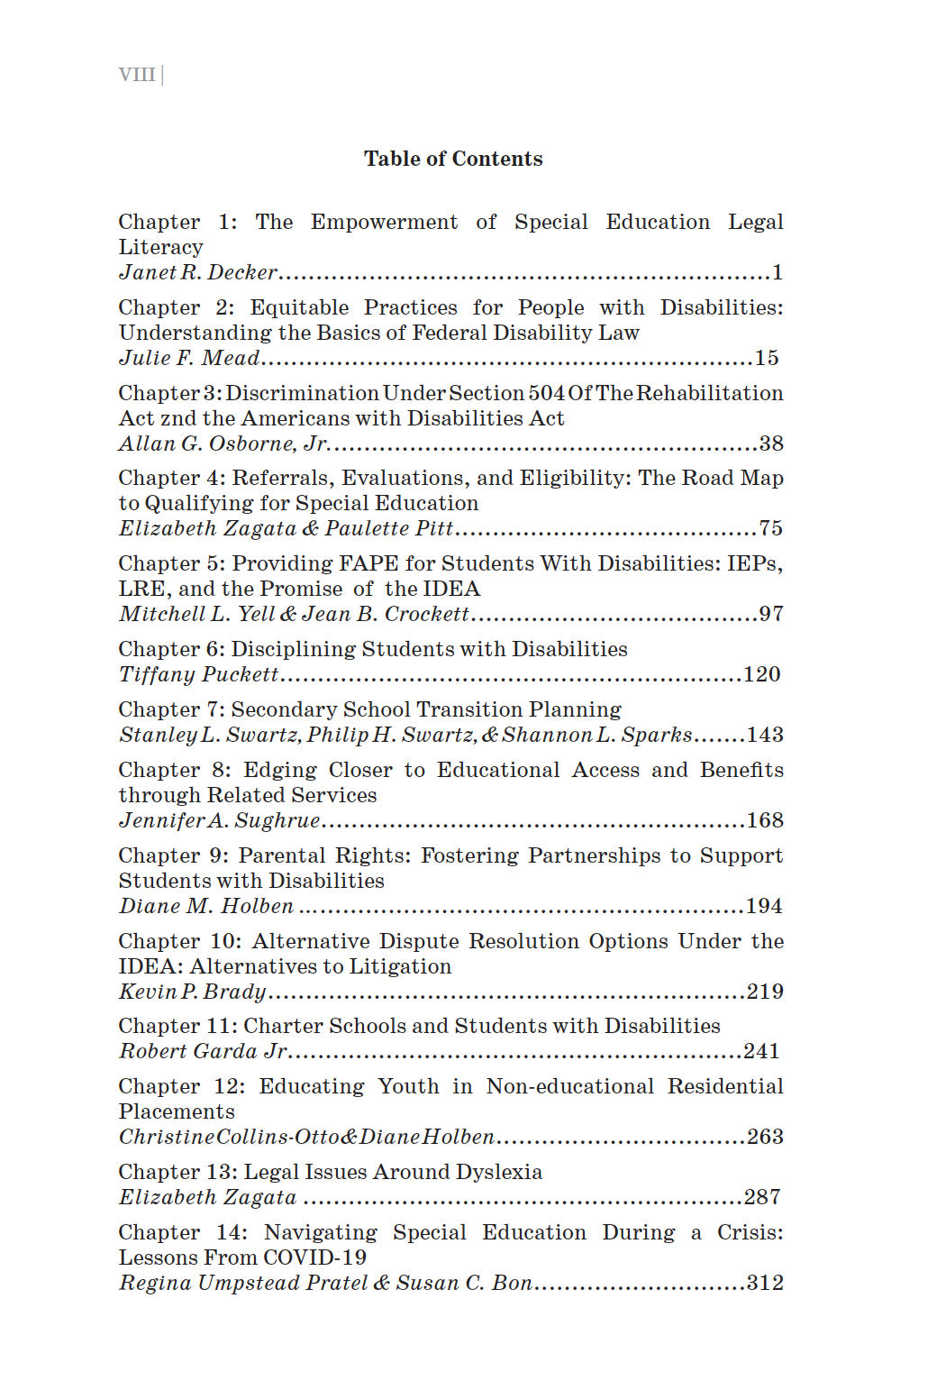
  February 19th at 4:00 EST:
  Meet the Authors of A Guide to Special Education Law (2nd ed.)

Slide 16



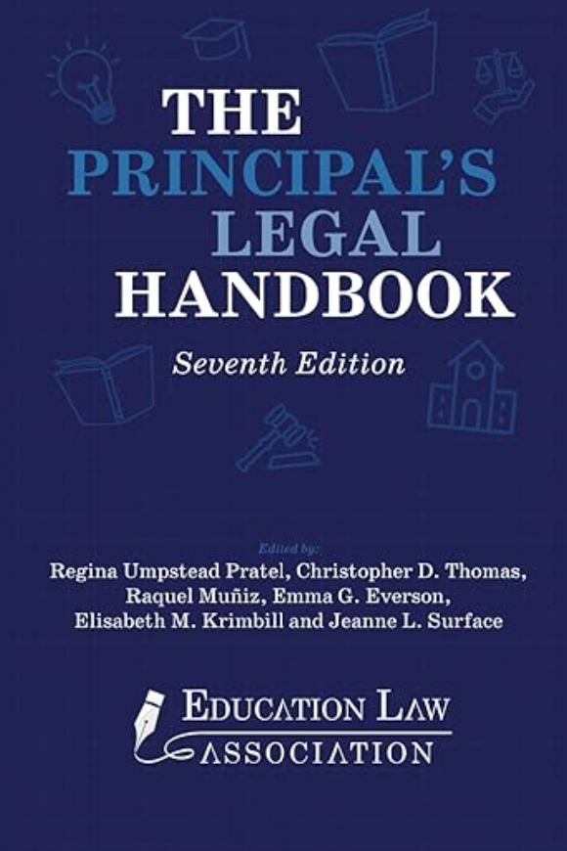

FEATURED ELA
RESOURCES

Slide 17
CONFERENCE INFO
October 21-24, 2026
Raleigh-Durham, North Carolina
Embassy Suites Raleigh Durham Research Triangle

Slide 18
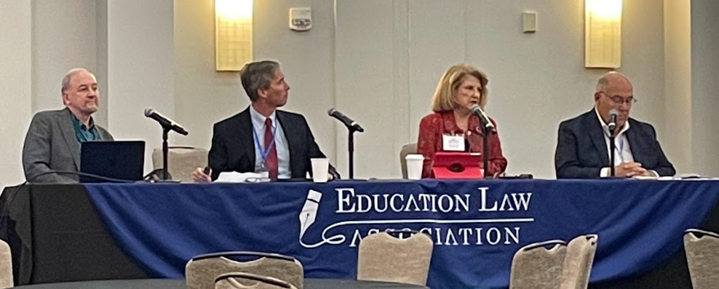
COST OF CONFERENCE
ELA Member= $525.00
ELA Student Member= $210.00
ELA Retired Member= $440.00
ELA Guest Member= $815.00
*All presenters must register for the conference by September 7th, 2026 (Labor Day)

Slide 19
WITH APPRECIATION
Thank you for attending our Coffee Talk

Slide 20
DISCUSSION WITH THE AUTHORS

Slide 21
TITLE
Content

